Slide 1

R markdown Tutorial

Slide 2
Learning objectives
What is R Markdown?
Why learn R Markdown?
Writing basic R Markdown documents
Knitting R Markdown documents to create html/pdf documents
Publishing documents with Rpub

Slide 3
What is R Markdown?
A software tool for creating professional documents from R code
It’s free
It runs on R Studio
You have to know a bit of R to use it
You can re-use your scripts on similar data and your workflow can be checked more easily

Slide 4
Why learn/use R Markdown?
Seems like lots of extra effort!
Benefits:
1 – Makes your work more reproducible
2 – Makes communicating your results easier
3 – Aids coding, using the philosophy of “Literate Programming”

Slide 5
What is literate programming?
Traditional workflow consists of two separate stages:
1 – Writing code and running scripts to perform your analysis (e.g. in Python, R, or any other setting)
2 – Writing the results of your analysis (e.g. word documents, powerpoint, etc.)

Slide 6
What is literate programming?
Literate programming is the idea of JOINING these two stages together, so that our code for analysis AND our documentation about the methods/results are all in the same document
R Markdown enables us to do this!

Slide 7
What is literate programming?
Again, why do you care about literate programming?
1 – Helps us to focus on what we are doing – writing code and documenting our results (i.e. stops us worrying about formatting)
2 – Allows us to keep track of complex analyses
3 – Helps with Reproducible Research!

Slide 8
R Markdown Basics
Markdown is a simple coding language
You write in plain text
There are only a small number of formatting options
R Markdown is the integration of Markdown with the R environment

Slide 9
R Markdown Basics
An R Markdown document consists of:
Code chunks – where you write and execute R code for your analyses
Plain text – forms the explanatory section of our end-product
Simple right…

Slide 10
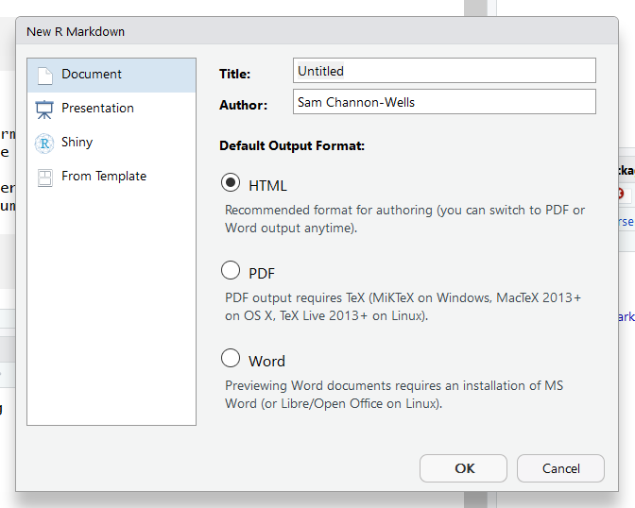
R Markdown - example
Create a new R Markdown document from R Studio by selecting “File” -> “New File” -> “R Markdown”
Enter your own title
Advanced options (not covered here – but feel free to explore!)

Slide 11
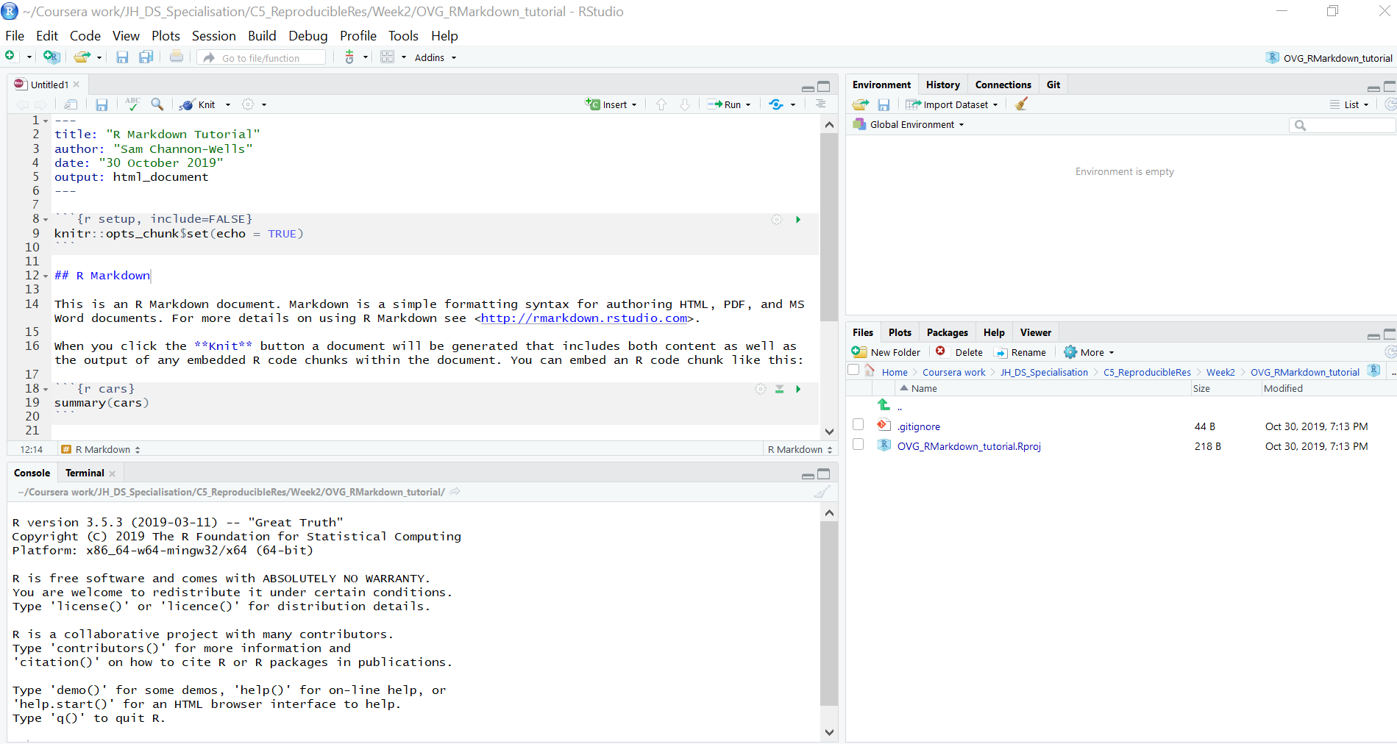
R Markdown - example
You will see this screen
Markdown document

Slide 12
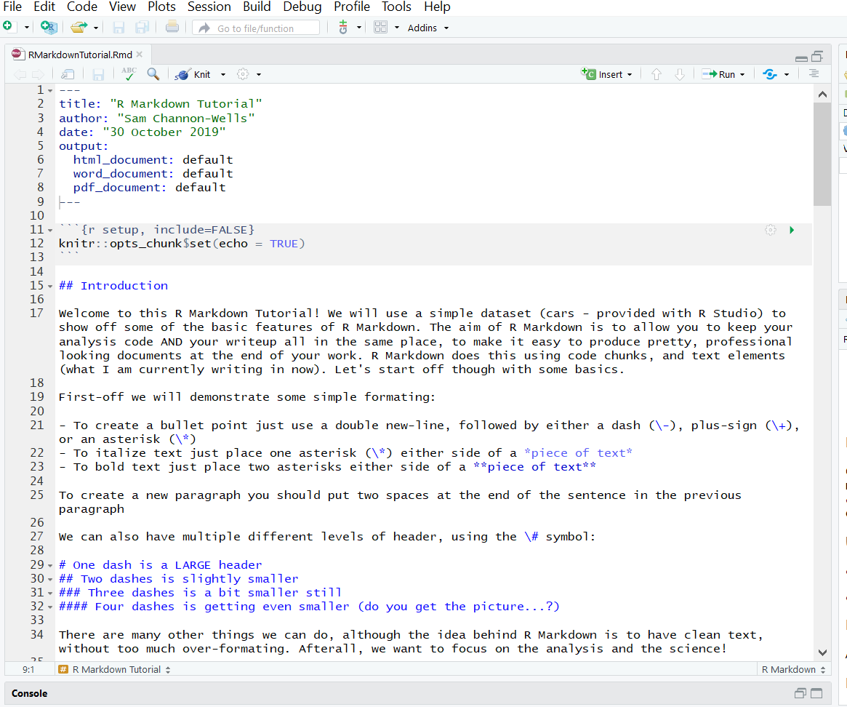
R Markdown - example
Set up options (don’t need to change)
Code chunk
Text element

Slide 13
R Markdown – code chunks
A code chunk is where you write your R code that will be run
Output from the code will appear in your final document
Each code chunk has:
Start of chunk
Chunk name
Chunk options
Code to be executed
End of chunk

Slide 14
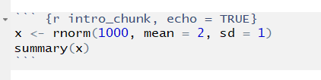
R Markdown – code chunks
Name of code chunk
Chunk options
Start of code chunk
Code to be executed
End of code chunk

Slide 15
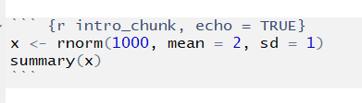
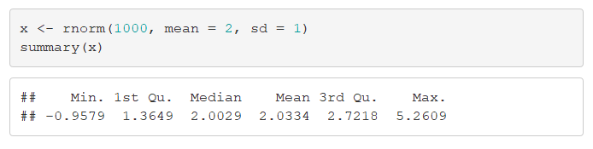
R Markdown – code chunks
R Markdown document
KNIT
Final html document

Slide 16
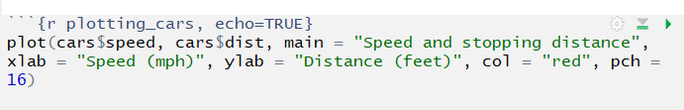
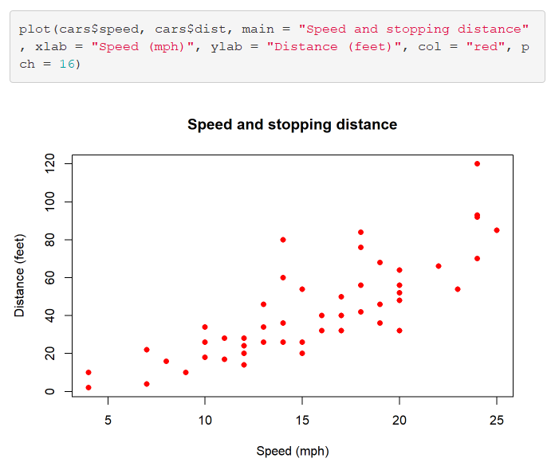
R Markdown – code chunks
KNIT
R Markdown document
Final html document

Slide 17
R Markdown – code chunks
Chunk options are placed in the initial start line of the code chunk
Chunk options allow you to change how the code chunk will be treated:
echo: set this equal to TRUE to print the code as well as the output of the code
include: set equal to FALSE if you don't want the code OR output of the code to appear in your document
eval: set equal to FALSE if you don't want the code to be evaluated (run) when knitting your document
warning: set equal to FALSE to NOT print warnings to your document when code is evaluated (use with caution!)
error: set equal to FALSE to NOT print error messages to your document (use with caution!)

Slide 18
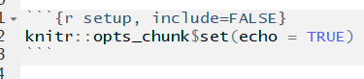
R Markdown – code chunks
We can set global options for all the chunks in our document in the very first code chunk:
These global options can be over-ruled in subsequent chunks (but this will only apply for the specific chunk)

Slide 19
R Markdown – text elements
Text elements come between code chunks, and the text lets readers know what your analysis is doing
This is where you write your thoughts and ideas in response to the output of your code
When someone reads the final document they will then be able to see your thought processes

Slide 20
R Markdown – text elements
Text element

Slide 21
R Markdown – text elements
R Markdown uses simple formatting based on a language called Markdown (surprise!)
The aim is to make formatting simple, so as not to distract from the actual analysis and science
Some options are shown below
For more details checkout:
https://rstudio.com/wp-content/uploads/2015/02/rmarkdown-cheatsheet.pdf

Slide 22
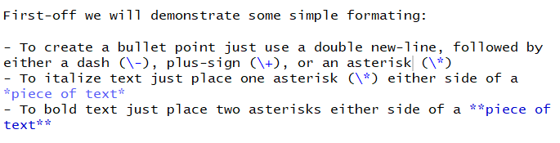
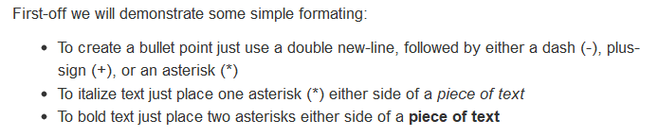
R Markdown – text elements
R Markdown document
KNIT
Final html document

Slide 23
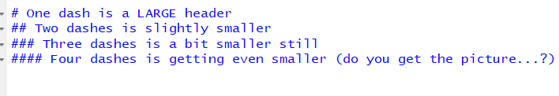
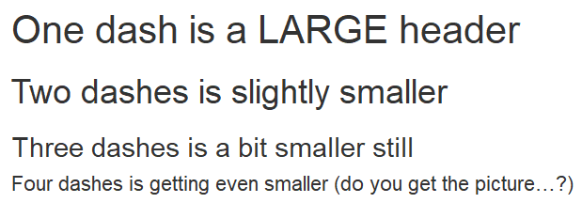
R Markdown – text elements
R Markdown document
KNIT
Final html document

Slide 24


R Markdown – text elements
R Markdown document
KNIT
Final html document

Slide 25
R Markdown – Knitting
Once you’ve completed your analysis you want to produce a professional looking document
To do this we use “Knitr”
This package fortunately comes fully installed and with a user interface in R-studio
If you open an R Markdown file you will see this

Slide 26
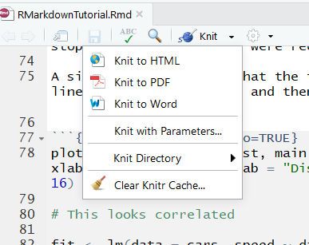
R Markdown – Knitting
Knit button, with dropdown options
Output options include html, PDF and Word document

Slide 27
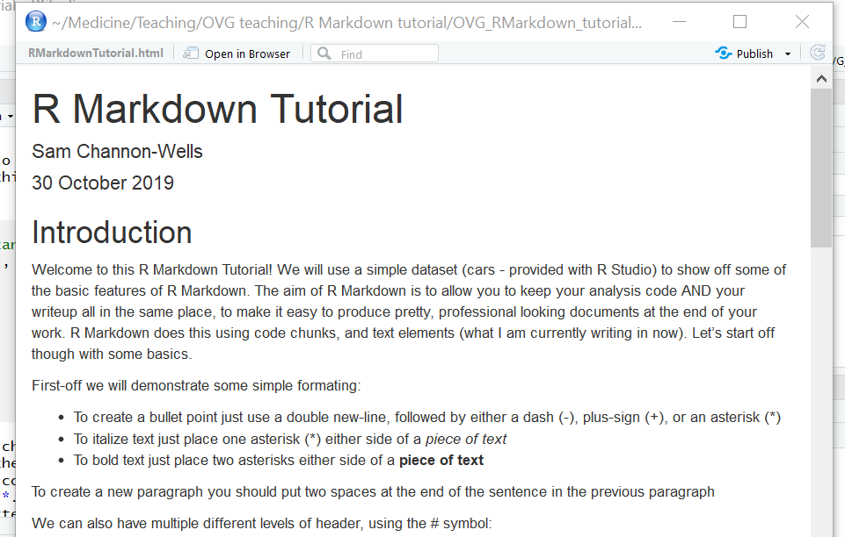
R Markdown – Knitting: html

Slide 28
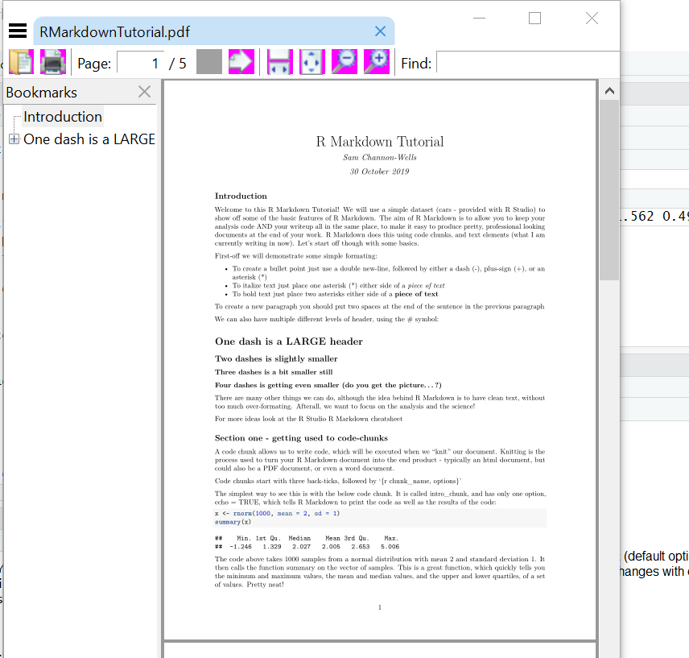
R Markdown – Knitting: PDF

Slide 29
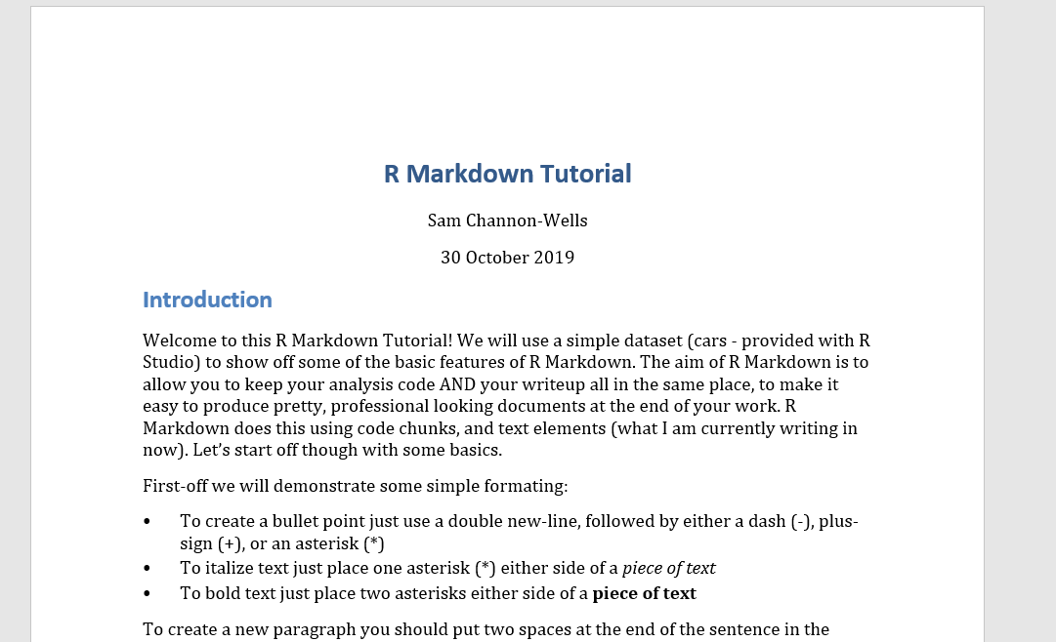
R Markdown – Knitting: Word

Slide 30
R Markdown – Knitting
Knitting a Markdown document (.Rmd) will generate a new file in your working directory (.pdf, .html, .docx)
These can then be shared with whoever you wish!
Whenever you updated you R Markdown document you can just re-knit the document, which will update your html, pdf or word file

Slide 31
R Markdown – R Pubs
You can also publish these html documents very easily using R pubs, a free service!
Step 1 – go to rpubs.com
Step 2 – sign up for a free account
Step 3 – knit your document to html

Slide 32
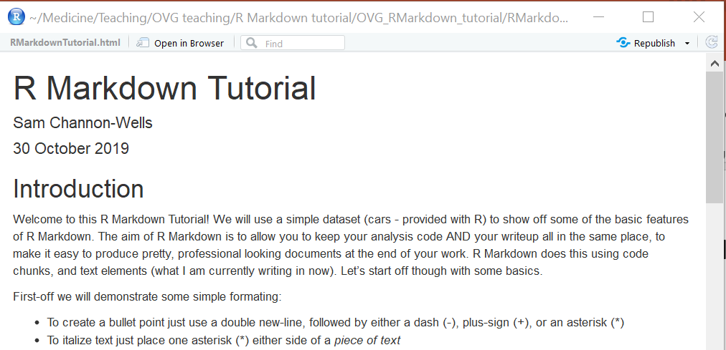
R Markdown – R Pubs
Step 4 – click on “publish” in top right (mine says republish as it’s already been published)

Slide 33
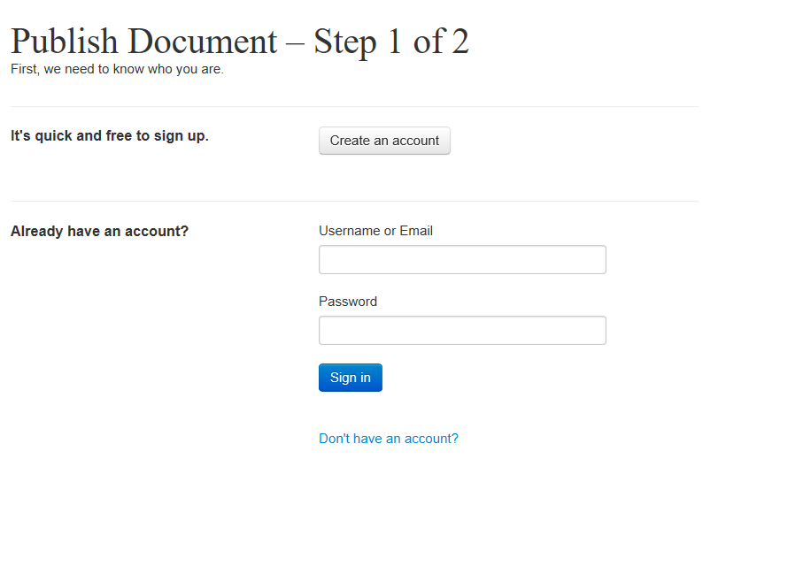
R Markdown – R Pubs
Step 5 – sign in to your R pubs account

Slide 34
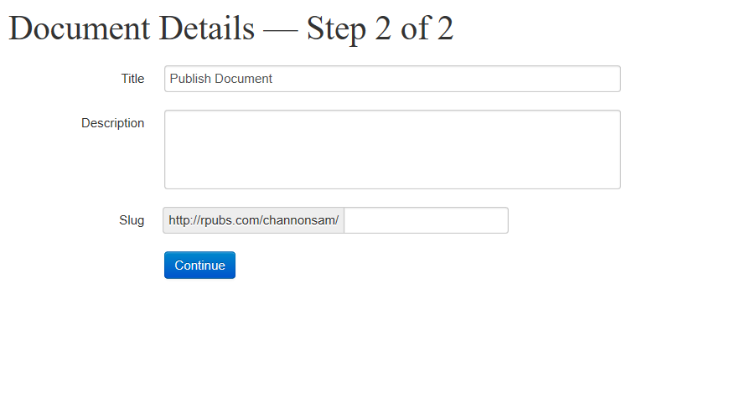
R Markdown – R Pubs
Step 6 – name and describe your document, and give it a url

Slide 35
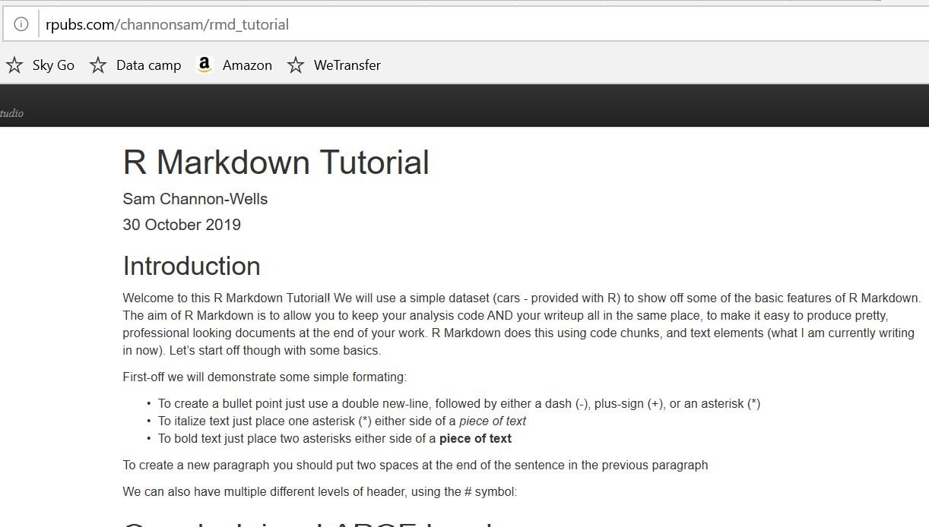
R Markdown – R Pubs
And you have published your document!
WARNING – anything published is immediately public
Share the URL to make sharing work even easier

Slide 36
R Markdown – wrapping up
Thank you for listening/reading this
I hope this helps you communicate your great work, and structure your projects more easily
But we’re not finished there…

Slide 37
R Markdown – wrapping up
The best way to learn R Markdown is to use it!

Slide 39

Download R and RStudio
Download R: http://www.r-project.org/
Can be used with or without user interface.
I suggest using RStudio: http://www.rstudio.com/
Useful resources / websites: http://www.rstudio.com/resources/training/online-learning/
http://www.statmethods.net
http://www.burns-stat.com/documents/tutorials
http://www.r-tutor.com/r-introduction
http://yihui.name/en/2010/10/on-the-gory-loops-in-r

Slide 40
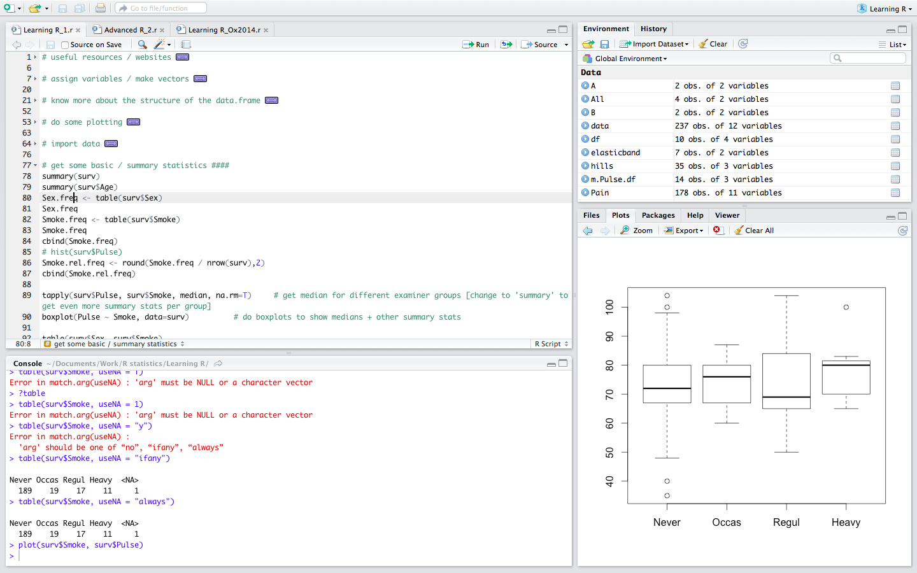
Your “script”:
saved list of commands
Workspace (uploaded or defined items) or history
Console: commands for execution – from script or typed
Files, plots, packages (R extensions) or help

Slide 41
Adjusting RStudio
RStudio preferences:
Code Editing – tick Soft-wrap R source files
You can adjust the appearance of
- code under “Appearances”
- RStudio windows under “Pane Layout”

Slide 42
Set working directory
Put 3 files I’ve sent by email in “Rcourse2014” into subfolder “data”
R upper corner – Project (None)
New Project
New Directory
Empty Project
Browse to search for location you want to use
Type Directory name, e.g. “Rcourse2014”
Create Project
L upper corner – R script
Save
Go to directory as above, e.g. “Rcourse2014”
Create new folder, called “scripts”
Type script name, e.g. “LearningR.r”
Save

Slide 43
General advise
Console vs. script
Script: good syntax and organisation
Some guidance: http://r-pkgs.had.co.nz/style.html
Use tab to auto-complete functions or previously used R objects
Break you script down in chunks and describe what you’re doing by using #, e.g.
# Basic functions ####
# calculator

Slide 44
Assign variables & generate vectors
a <- 1
a
b <- c(1, 2) # combine values
b
c <- c("A", "B") # combine characters
c
d <- 1:10 # combine integers 1 to 10
length(b)
sum(b)
sum(c) # does not work for characters
mean(d)
str(c)

Slide 45
Get your data into R
Generate in R
Import existing local data
Import remote data (e.g. from the Web)

Slide 46
data.frame()
Generate “table”:
5 participants in each of 2 groups (n = 10), 2 study time points and 1 outcome variable
row.names | Participant | Group | V1 | V2
1 | a | G1 | 1 | 11
2 | b | G1 | 2 | 12
3 | c | G1 | 3 | 13
4 | d | G1 | 4 | 14
5 | e | G1 | 5 | 15
6 | f | G2 | 2 | 20
7 | h | G2 | 4 | 21
8 | i | G2 | 6 | 22
9 | k | G2 | 8 | 23
10 | l | G2 | 10 | 24

Slide 47
vector()
Participant <- letters[1:10]
Group <- rep(c("G1","G2"), each = 5)
V1 <- c(1:5, c(2, 4, 6, 8, 10))
V2 <- c(11:15, seq(from = 20, to = 28, by = 2))

Slide 48
data.frame()
data.frame(Participant, Group, V1, V2)
data.frame(Participant = letters[1:10],
Group = rep(c("G1","G2"), each = 5),
V1 <- c(1:5, c(2, 4, 6, 8, 10)),
V2 <- c(11:15, seq(from = 20, to = 28, by = 2)))
Tip: To use keyboard shortcut: Highlight code
→ Ctrl + Enter (Windows) / cmd + Enter (Mac)

Slide 49
Participant Group V1 V2
1 a G1 1 11
2 b G1 2 12
3 c G1 3 13
4 d G1 4 14
5 e G1 5 15
6 f G2 2 20
7 g G2 4 22
8 h G2 6 24
9 i G2 8 26
10 j G2 10 28
>

Slide 50
Explore data.frame() called df
df <- data.frame(Participant, Group, V1, V2)
dim(df) # dimensions
head(df) # first 6 rows
tail(df) # last 6 rows
str(df) # structure of df
# also can click on df or arrow under “Environment”
'data.frame': 10 obs. of 4 variables:
$ Participant: Factor w/ 10 levels "a","b","c","d",..: 1 2 3 4 5 6 7 8 9 10
$ Group : Factor w/ 2 levels "G1","G2": 1 1 1 1 1 2 2 2 2 2
$ V1 : num 1 2 3 4 5 2 4 6 8 10
$ V2 : num 11 12 13 14 15 20 22 24 26 28

Slide 51
Extract and analyse contents of df
df[1, ] # first row
df[, 3] # third column
df[, c(1,3)] # first and third column
df[1, 3] # row 1, column 3
df$Participant # shows content of first column
# Tip: use tab after typing $ to auto-complete
df[, "V1"] # alternative to above
df["V1"] # same but in df structure
sum(df$V1)
mean(df$V1)
median(df$V1)
summary(df$V1)

Slide 52
Extract and analyse contents of df
range(df$V1) # this gives min & max values
max(df$V1) - min(df$V1) # real range
IQR(df$V1) # inter-quartile range
quantile(df$V1) # quantiles 0,25,50,75,100%
quantile(df$V1, c(.03,.5,.97)) # quantiles 3,50,97%

Slide 53
Extract and analyse contents of df
# display data with certain pattern
df[df$V1 > 4, ] # only rows with pattern
df[df$V1 > 4 & df$V2 > 20, ] # pattern combination
subset(df, V1 > 4 & V2 > 20) # same
subset(df, Group == "G1") # select group
subset(df, Group != "G2") # same
high <- df$V1 > 4 # logical vector
high # display
df[high,] # only rows with V1 > 4
df$V1[high] # select from V1 those > 4
df[high,]$V1 # same

Slide 54
plot() and boxplot()
# dot plot
plot(df$V1, df$V2) # not very helpful in this case
# boxplots
plot(df$Group, df$V1)
boxplot(V1 ~ Group, data = df)
boxplot(V1 ~ Group, data = df,
col = c("red","blue"))

Slide 55
plot() and boxplot()
library(MASS) # package with data
survey <- survey # load built-in data
head(survey)
str(survey)
plot(survey$Age, survey$Pulse) # dot plot
plot(Pulse ~ Age, data = survey, col=survey$Sex)
plot(survey$Sex ~ survey$Smoke)
# dot plot ('correlation')
boxplot(survey$Pulse ~ survey$Sex, col=survey$Sex)
plot(Pulse ~ Sex, data = survey, col=survey$Sex)

Slide 56
import local data
surv <- read.table("data/survey.txt", header = T, stringsAsFactors = F, sep = "\t")
?read.table
library(gdata)
surv_xls <- read.xls("data/survey.xlsx", stringsAsFactors = F)
surv_csv <- read.csv("data/survey.csv", header = T, stringsAsFactors = F)

Slide 57
factor() & as.factor()
str(surv)
'data.frame': 237 obs. of 13 variables:
$ Sex : chr "Female" "Male" "Male" "Male" ...
...
$ Smoke : chr "Never" "Regul" "Occas" "Never" ...
surv$Sex <- factor(surv$Sex) # or as.factor
unique(surv$Smoke)
[1] "Never" "Regul" "Occas" "Heavy" NA
surv$Smoke <- factor(surv$Smoke, levels = c("Never", "Occas”, "Regul", "Heavy"))

Slide 58
rbind() & cbind()
new_participant <- c("k", "G2", 14, 35)
rbind(df, new_participant)
rbind(df, c("k", "G2", 14, 35))
Warning message:
In `[<-.factor`(`*tmp*`, ri, value = "k") :
invalid factor level, NA generated
df$Participant <- as.character(df$Participant)
df <- rbind(df, new_participant)
df <- cbind(df, 1:10)
df$V3 <- 1:10

Slide 59
merge()
new_df <- data.frame(Participant = letters[1:10],
Group = rep(c("G1","G2"), each = 5),
V3 = df$V1 + 2,
V4 = df$V2 + 4)
merge(df, new _df)
df_all <- merge(df, new_df)
df_all <- merge(df, new_df, by = "Participant")
merge(df, new_df, by = c("Participant", "Group"))

Slide 60
geometric.mean()
geometric.mean
Error: object 'geometric.mean' not found
Go onto “Packages” R lower corner, select “install”, type “psych”, then install
Under “Packages” tick box next to “psych” or type library(psych) in console
?geometric.mean # calls help page for function
geometric.mean(df$V1)
exp(mean(log(df$V1), na.rm = TRUE)) # alternative

Slide 61
Confidence intervals, sd() & se()
# For 95% confidence interval use 1-sample t-test
t.test(df$V1)$conf.int # both CIs
t.test(df$V1)$conf.int[1] # low CI
t.test(df$V1)$conf.int[2] # high CI
# confidence intervals around geometric mean
exp(t.test(log(df$V1))$conf.int[2]) # high CI
exp(t.test(log(df$V1))$conf.int[1]) # low CI
sd(df$V1, na.rm = T) # standard deviation
library(sciplot)
se(df$V1, na.rm = T) # standard error

Slide 62
two sample t.test()
# compares means of independent data sets
# data sets identically and normally distributed
t.test(df$V1, df$V2) # wrong as not independent
t.test(df$V1, df$V2, paired = T) # paired t-test
t.test(df$V1 ~ df$Group, paired = T) # same
G1V1 <- df$V1[df$Group == "G1"]
G2V1 <- df$V1[df$Group == "G2"]
t.test(G1V1, G2V1) # if normal distribution
t.test(df$V1 ~ df$Group) # same
t.test(log(G1V1), log(G2V1)) # better
t.test(log(df$V1) ~ df$Group) # same

Slide 63
cor.test()
head(hills)
cor(hills) # correlating everything
round(cor(hills), 2) # round to 2 decimal points
# by default Pearson's correlation, can be defined
cor.test(hills$dist, hills$time)
cor.test(hills$dist, hills$time)$p.value # p-value
cor.test(hills$dist, hills$time)$estimate # Pearson's r
plot(hills$time ~ hills$dist) # correlation plot
abline(lm(hills$time ~ hills$dist), col = "steelblue")
# linear regression line

Slide 64
just a little bit of ggplot()
library(ggplot2)
ggplot(hills, aes(dist, time)) + geom_point() + geom_smooth()
ggplot(hills, aes(dist, time)) + geom_point() + geom_smooth(method = "lm")
ggplot(hills, aes(dist, time)) + geom_point() + geom_smooth(method = "lm") + theme_bw ()
ggplot(hills, aes(dist,time)) + geom_point(size = 5) + geom_smooth(method = "lm", size = 1) + theme_bw() + theme(axis.title = element_text(size = 16), axis.text = element_text(size = 14)) + xlab("Distance") + ylab("Time (min)")

Slide 65
table(), hist() & barplot()
table(surv$Smoke, useNA = "always")
table(surv$Sex, surv$Smoke)
plot(table(surv$Sex, surv$Smoke), las = 1, main = "", cex = 1.2) # mosaic plot
plot(table(surv$Sex, surv$Smoke, surv$Exer))
as.data.frame(table(surv$Sex, surv$Smoke, surv$Exer))
hist(surv$Pulse) # histogram
hist(surv$Pulse, breaks = 10) # change bin size
barplot(table(surv$Smoke)) # barplot

Slide 66
paste()
# simple but very useful function to concatenate character vectors
paste("A", 1:6)
paste("A", 1:6, sep = ".")
paste(c("A","B"), 1:6, sep = ".")
paste("A", 1:6, sep = ".", collapse = "|")
paste(df$Participant, df$Group, sep = "_")

Slide 67
functions
fun.mean <- function(x){
mean <- mean(x, na.rm = T)
median <- median(x, na.rm = T)
GeoMean <- geometric.mean(x, na.rm = T)
CI.hi <- exp(t.test(log(x))$conf.int[2])
CI.lo <- exp(t.test(log(x))$conf.int[1])
sd <- sd(x, na.rm = T)
IQR <- IQR(x, na.rm = T)
return(round(rbind(mean, median, GeoMean, sd, IQR, CI.hi, CI.lo), 2))
}
fun.mean(surv$Pulse)

Slide 68
reshape
Pulse.df <- data.frame(calculation = rownames(fun.mean(surv $Pulse)),
Pulse1 = fun.mean(surv$Pulse),
Pulse2 = fun.mean(surv$Pulse2))
library(reshape2)
# converting to 'long' format
m.Pulse.df <- melt(Pulse.df, id = "calculation")
str(m.Pulse.df)
# look for missing values
dcast(m.Pulse.df, variable ~ calculation, length)
# convert back to 'short' format
dcast(m.Pulse.df, calculation ~ variable, value.var = "value")
Pulse.df

